Slide 1
The am Atmospheric Model
Introduction and Applications at the Submillimeter Array
Scott Paine・Smithsonian Astrophysical Observatory
Astro Water Vapor・April 29, 2025

Slide 2
Outline
Introduction to am
What it does・How it works
Spectroscopic data and validation ・Sources of atmospheric data
The SMA forecast tool
The US Global Forecast System (GFS)
SMA forecast plots・Comparisons with the SMA 225 GHz tipper
Refraction and pointing at the SMA
Climatological model based on NASA MERRA-2
Refraction under various temperature and humidity scenarios

Slide 3
Introduction to am
What it does
Optical depth
LTE radiative transfer
Refraction, spherical geometry
Instrument models, Jacobians, and more
How it works
POSIX-style command-line utility (but see Brian Svoboda’s March talk!)
Definition of computation and atmospheric model from stdin or file
Output to stdout and stderr
Data sources
Spectroscopic data (HITRAN, AER, JPL, others) built in, tied to version
Atmospheric model from user or am cookbook

Slide 4
Example am workflows
$ am [option] config_file [param1 param2…] >file.out 2>file.err
$ cat header.amc layers_tag.amc | am - >tag.out 2>tag.err
$ am – 2>/dev/null # Knock out a quick Planck spectrum
f 0 GHz 1000 GHz 25 GHz
output f I watt*cm^-2*GHz^-1*sr^-1
T0 2.7 K
^D
0.000000e+00 0.000000e+00
2.500000e+01 4.117687e-14
5.000000e+01 1.287021e-13
7.500000e+01 2.227293e-13
1.000000e+02 2.999975e-13
1.250000e+02 3.501551e-13
1.500000e+02 3.717676e-13
1.750000e+02 3.686681e-13
...

Slide 5
A simple am configuration file
# Example 2.4 - Simple atmospheric model with constant RH and cloud
#
# T(P) from US standard atmosphere
?
? Usage: am example2.4.amc RH% cloud_LWP
? Example: am example2.4.amc 75% 200 g*m^-2
?
f 0 GHz 350 GHz 25 MHz
output f GHz tau neper
T0 2.7 K
layer # empty layer for top of atmosphere
Pbase 0 mbar
Tbase 217 K
layer
Pbase 200 mbar # z = 11.8 km
Tbase 217 K
column dry_air hydrostatic
column h2o RHi %1
layer
Pbase 400 mbar # z = 7.2 km
Tbase 241 K
column dry_air hydrostatic
column h2o RHi %1
layer
Pbase 600 mbar # z = 4.2 km
Tbase 261 K
column dry_air hydrostatic
column h2o RH %1
layer
Pbase 800 mbar # z = 1.9 km
Tbase 275 K
column lwp_abs_Rayleigh %2 %3 # cloud layer
column dry_air hydrostatic
column h2o RH %1
layer
Pbase 1000 mbar # z = 0.1 km
Tbase 288 K
column dry_air hydrostatic
column h2o RH %1

Slide 6
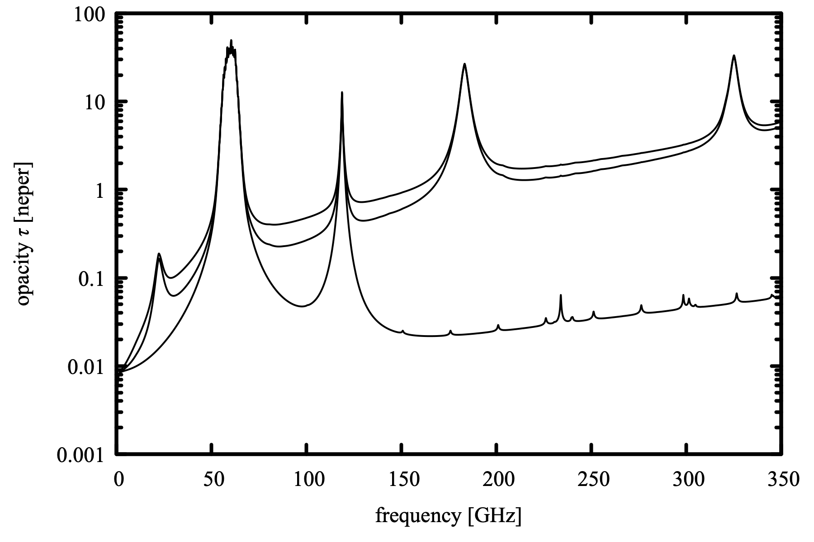
Running this file
$ am example2.4.amc 75% 200 g*m^-2 >example2.4_75_200.out 2>example2.4_75_200.err
Contents of example2.4_75_200.out
0.0000000e+00 0.000000e+00
2.5000000e-02 8.699308e-05
5.0000000e-02 3.006530e-04
7.5000000e-02 5.754582e-04
1.0000000e-01 8.825195e-04
1.2500000e-01 1.210600e-03
1.5000000e-01 1.551812e-03
1.7500000e-01 1.899000e-03
2.0000000e-01 2.245979e-03
2.2500000e-01 2.587791e-03
…
3.4977500e+02 5.872477e+00
3.4980000e+02 5.875197e+00
3.4982500e+02 5.877926e+00
3.4985000e+02 5.880663e+00
3.4987500e+02 5.883410e+00
3.4990000e+02 5.886166e+00
3.4992500e+02 5.888930e+00
3.4995000e+02 5.891704e+00
3.4997500e+02 5.894487e+00
3.5000000e+02 5.897279e+00

Slide 7
The stderr output example2.4_75_200.err is an annotated version of the original config file that shows what happened. It is a runnable config file that will reproduce the original computation.
# am version 14.0 (build date Sep 26 2024 13:20:00)
# run time 0.004 s
# dcache hit: 45 miss: 0 discard: 0
f 0 GHz 350 GHz 25 MHz
output text f GHz tau neper
tol 0
selfbroad_vmr_tol 0.003
geometry plane-parallel
refract none
za 0 deg
PTmode Pbase Tbase
g 980.665 cm*s^-2
dg_dz 0 s^-2
T0 2.7 K
layer
Pbase 0 mbar
Tbase 217 K
layer
# P 100 mbar
# T 217 K
# dP 200 mbar
Pbase 200 mbar
Tbase 217 K
Mair 28.964 h2o o3 (28.9625)
lineshape Gross ch4 co co2 n2o o2_uncoupled
lineshape VVW_coupled o2_coupled
lineshape VVH_750 h2o_lines
column dry_air hydrostatic (0.999865) (4.23999e+24 cm^-2)
column h2o RHi 75% (vmr 0.0001353) (5.7383e+20 cm^-2)
…
…
layer
# P 700 mbar
# T 268.502 K
# dP 200 mbar
Pbase 800 mbar
Tbase 275 K
Mair 28.964 h2o o3 (28.9132)
lineshape Gross ch4 co co2 n2o o2_uncoupled
lineshape VVW_coupled o2_coupled
lineshape VVH_750 h2o_lines
column lwp_abs_Rayleigh 200 g*m^-2 (vmr 0.0001574)
column dry_air hydrostatic (0.995202) (4.22742e+24 cm^-2)
column h2o RH 75% (vmr 0.004641) (1.97128e+22 cm^-2)
layer
# P 900 mbar
# T 281.862 K
# dP 200 mbar
Pbase 1000 mbar (observing level)
Tbase 288 K
Mair 28.964 h2o o3 (28.8612)
lineshape Gross ch4 co co2 n2o o2_uncoupled
lineshape VVW_coupled o2_coupled
lineshape VVH_750 h2o_lines
column dry_air hydrostatic (0.990615) (4.21551e+24 cm^-2)
column h2o RH 75% (vmr 0.009385) (3.99366e+22 cm^-2)
#
# column densities [cm^-2], including scale factors
#
# zenith line-of-sight
# total (6 layers):
# dry_air 2.115846e+25 2.115846e+25
# h2o 6.852814e+22 6.852814e+22
# (20500.8 um_pwv) (20500.8 um_pwv)
# lwp_abs_Rayleigh 6.685400e+20 6.685400e+20
# (0.2 kg*m^-2) (0.2 kg*m^-2)
#

Slide 8
am data sources
Molecular line data
Mostly HITRAN + TIPS
H₂O line data from AER, Inc.
Other data from JPL line catalog and literature
Continua
H₂O continuum is MT-CKD from AER, Inc.
Collision-Induced Absorption (CIA) from Borysov-Frommhold
Other data
Refractivity, physical and dielectric properties of water and ice, etc.
Complete data citations in the manual and source code
Summary references available by giving the command
$ am -r

Slide 9
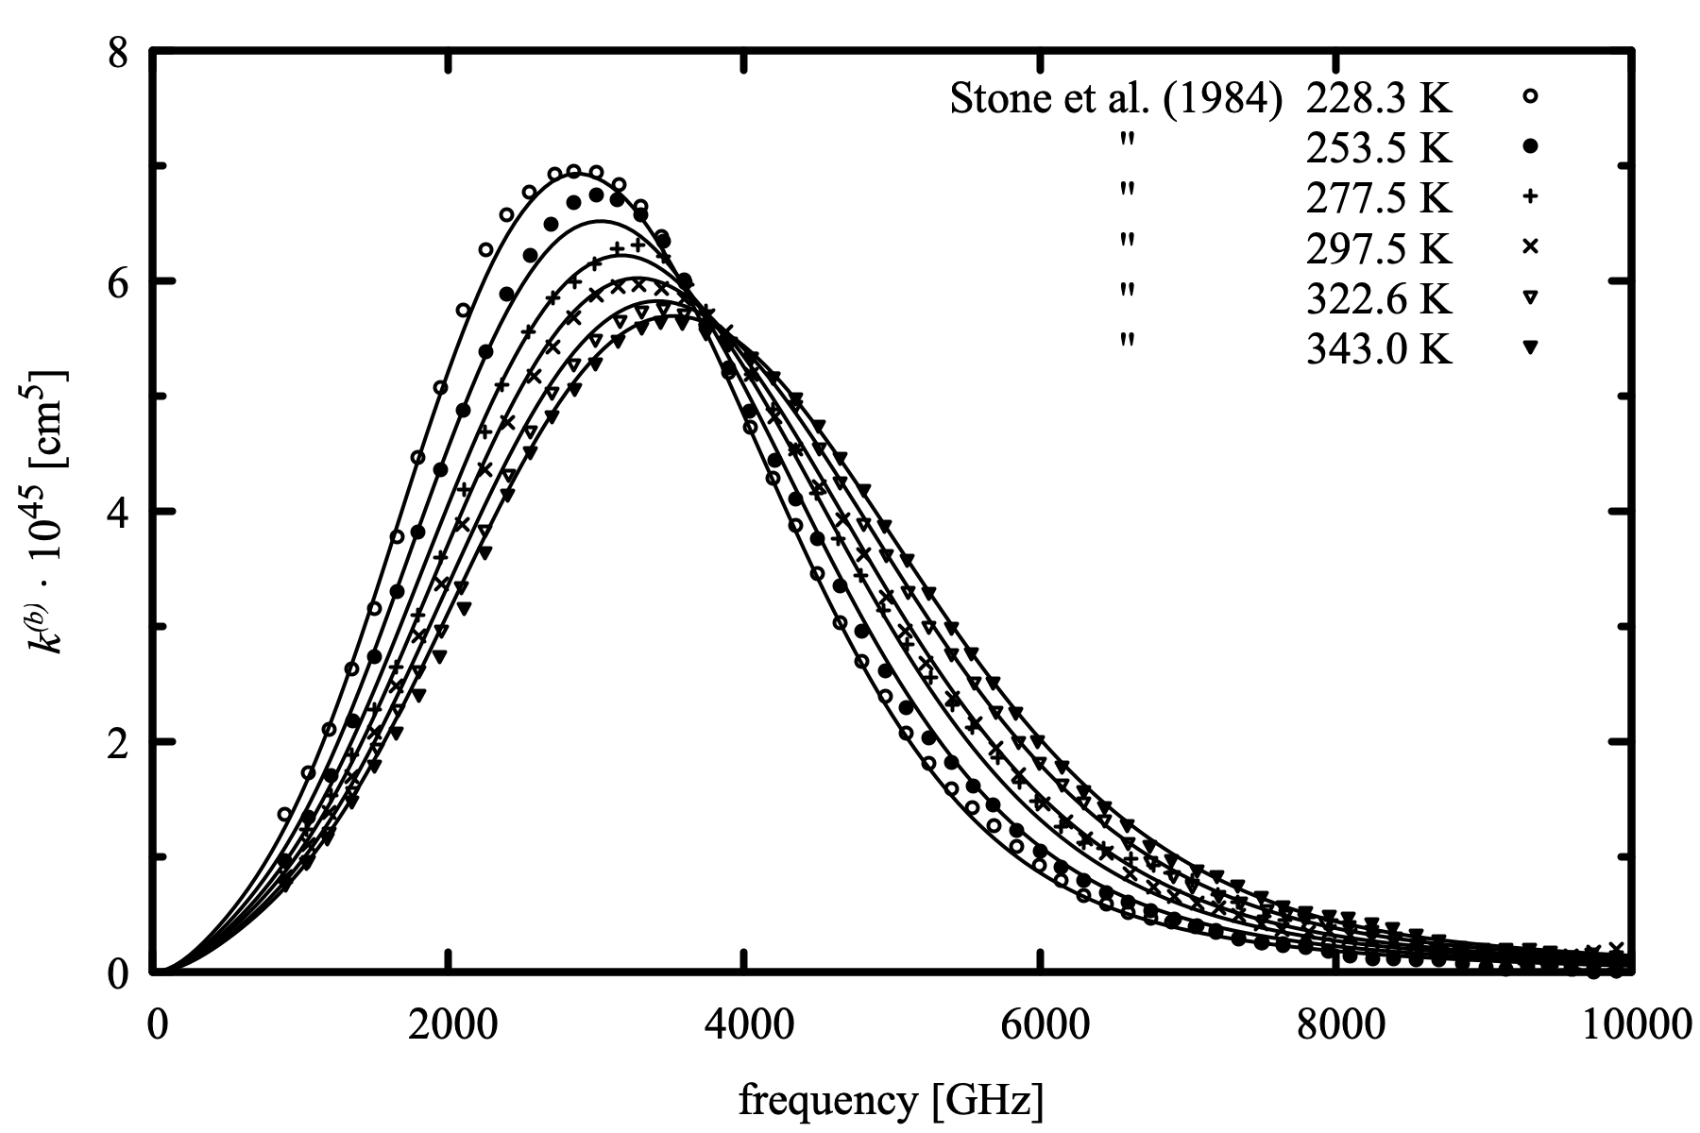
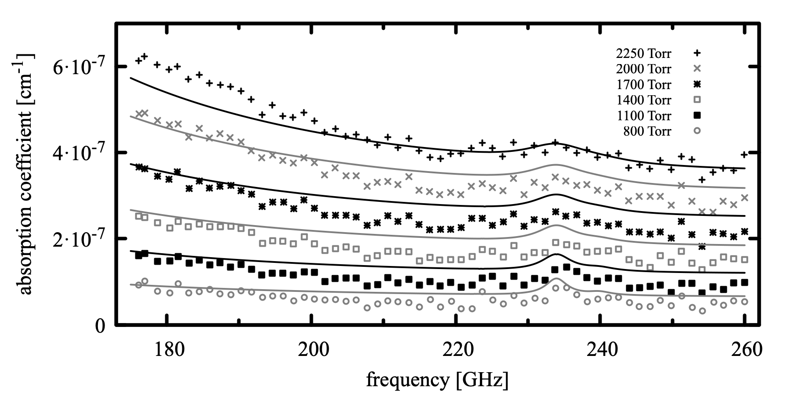
am validation – literature examples
N₂-N₂ CIA computed by am, compared with laboratory measurements from Stone, et al. 1984, Can. J. Phys. 62:338
O₂ absorption computed by am, compared with cavity ringdown measurements from Meshkov and De Lucia 2007, JQSRT 108:256

Slide 10
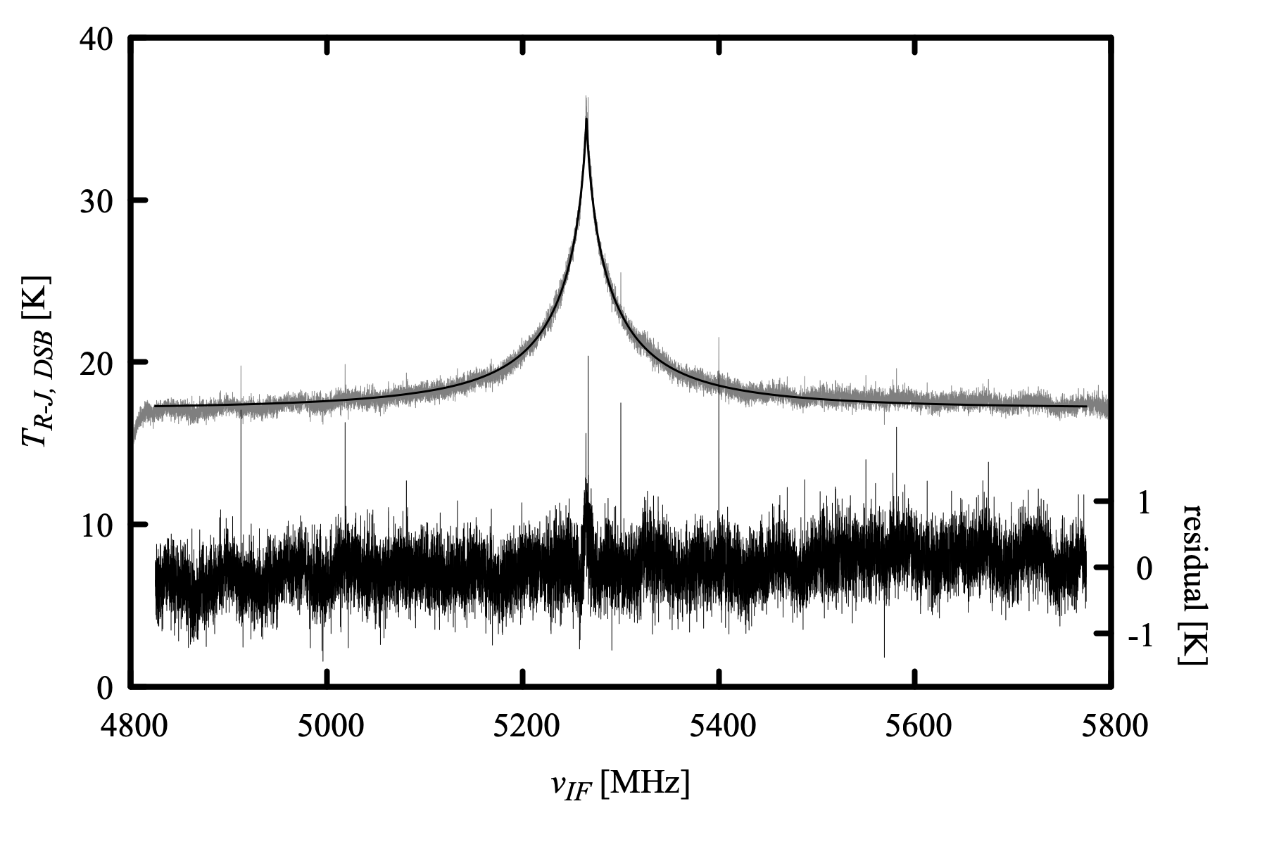
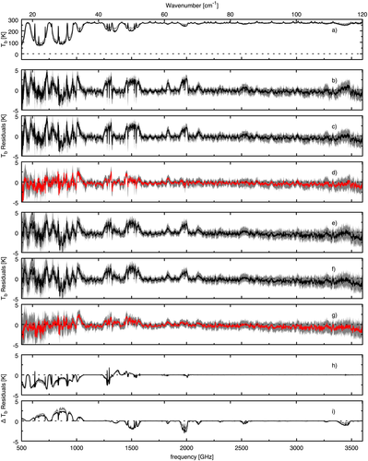
am validation – field measurements
231.3 GHz O₃ line measured with the SMA. Atmospheric state from contemporaneous Hilo radiosonde plus MERRA-2 stratosphere
RHUBC-II (Cerro Toco, 2009) analysis of SAO FTS spectral residuals, with atmospheric state from contemporaneous sonde launches. (Plot from Mlawer et al. 2019, JGR Atmospheres 124:8134)

Slide 11
Sources of atmospheric state data
Radiosondes
Useful if your application is near a launch site!
Dedicated launch campaigns (e.g. RHUBC-II, early ALMA site testing)
Forecasts
ECMWF (European Center for Medium Range Weather Forecasting)
GFS (US National Weather Service Global Forecast System)
UK Met Office, others
Reanalyses
Like forecast models but run retrospectively, assimilating a greater range of measurements, with no latency.
Examples are NASA MERRA-2 and ECMWF ERA-5
Very useful for non-real-time and climatological analyses.

Slide 12
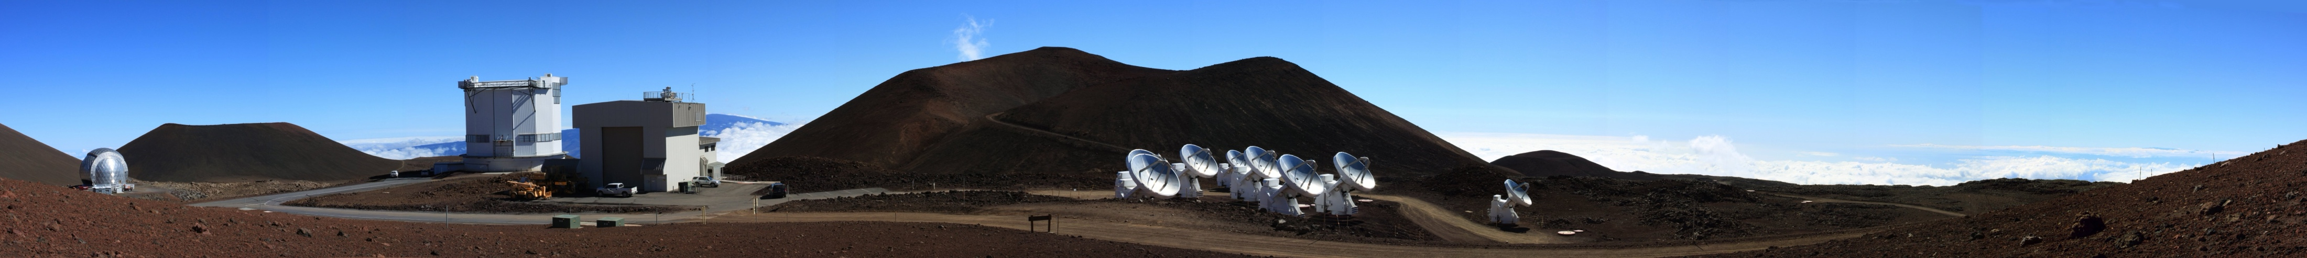
The SMA forecast tool
The problem in 2019
SMA observations are queue scheduled according to required weather
MaunaKea Weather Center PWV forecast had 6-hour resolution, was not updated on weekends
Needed a backup ”nowcast” to cover 225 GHz tipper downtime
sma-met-forecast
Downloads and interpolates GFS forecast data to observatory position
Uses am to compute integrated moisture, ozone, and 225 GHz opacity
Generates forecast plots for use by scheduler and telescope operators
Available on github, and easily adapted to any site
Image credit: Glen Petipas

Slide 13
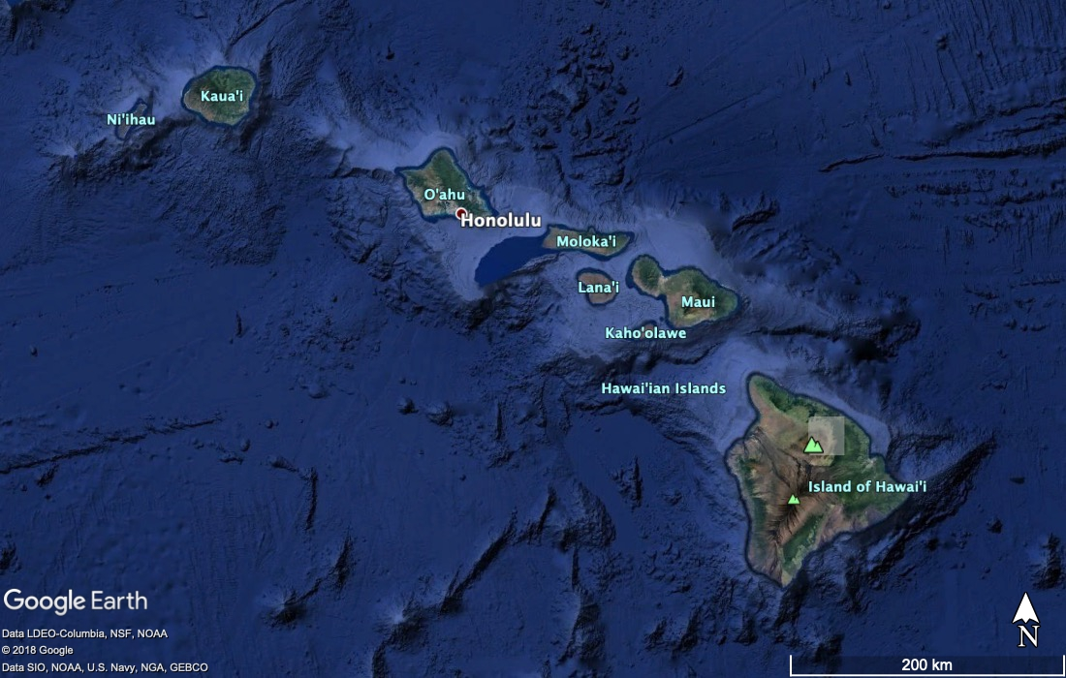
NOAA GFS forecast
Primary US operational forecast system, distributed at no cost to users
6-hourly production schedule (0, 6, 12, 18 UT)
Since 2019, runs on FV3 finite-element model (replacing spectral model)
Computed on cubed-sphere horizontal + Lagrangian vertical coordinates
Available to users on 0.25 degree lat-lon × 46 pressure level grid
Hourly resolution to 5 days
3-hourly to 16 days
Shaded area is a 0.25 degree grid box bounding MaunaKea, Hawaii

Slide 14
sma-met-forecast
Download
6-hourly cron job launched when new forecast expected available
For grid bounding MaunaKea, downloads all forecast time steps
Rate-limited following NOAA guidance, takes 30-40 minutes
Process
For each forecast time step, generate an am layer stack from interpolated GFS temperature, humidity, cloud moisture, and ozone
Compute 225 GHz optical depth, extract integrated column densities from am stderr output
Tabulate and archive
Plot
Generate 5-day and 16-day forecast plots for scheduler and observers

Slide 15
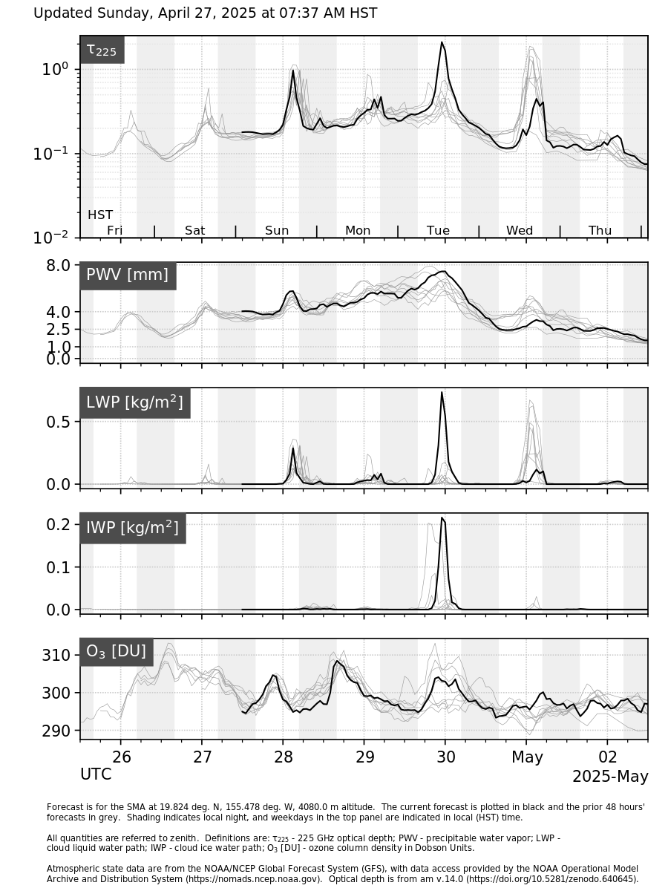
5-day forecast plot. The current forecast is plotted in black. The prior 48 hours’ forecasts are plotted in grey, serving as a “time-lag ensemble” to assess forecast stability.

Slide 16
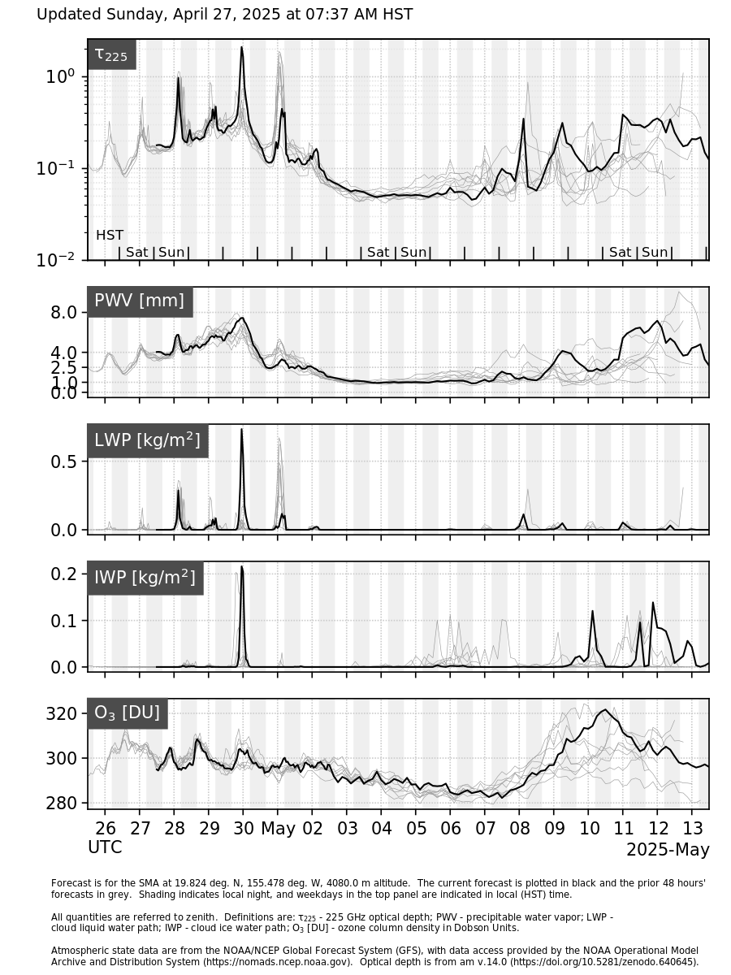
16-day forecast plot. View skeptically!

Slide 17
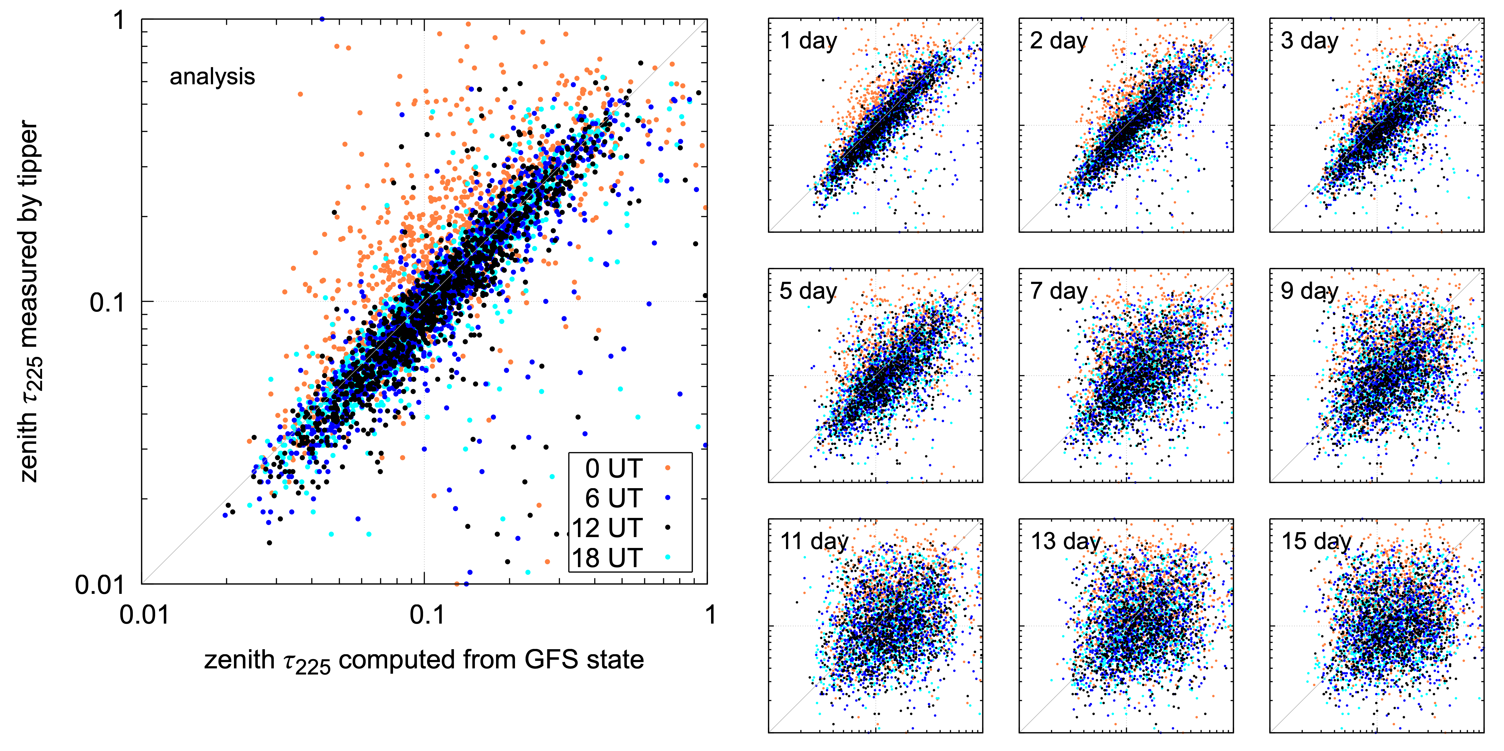
Forecast skill assessed with 225 GHz tipper
Hawaii is 10 hours behind UT, so orange points at 0 UT are 2 PM local time, typically affected by clouds.
These are unresolved by GFS at grid scale.

Slide 18
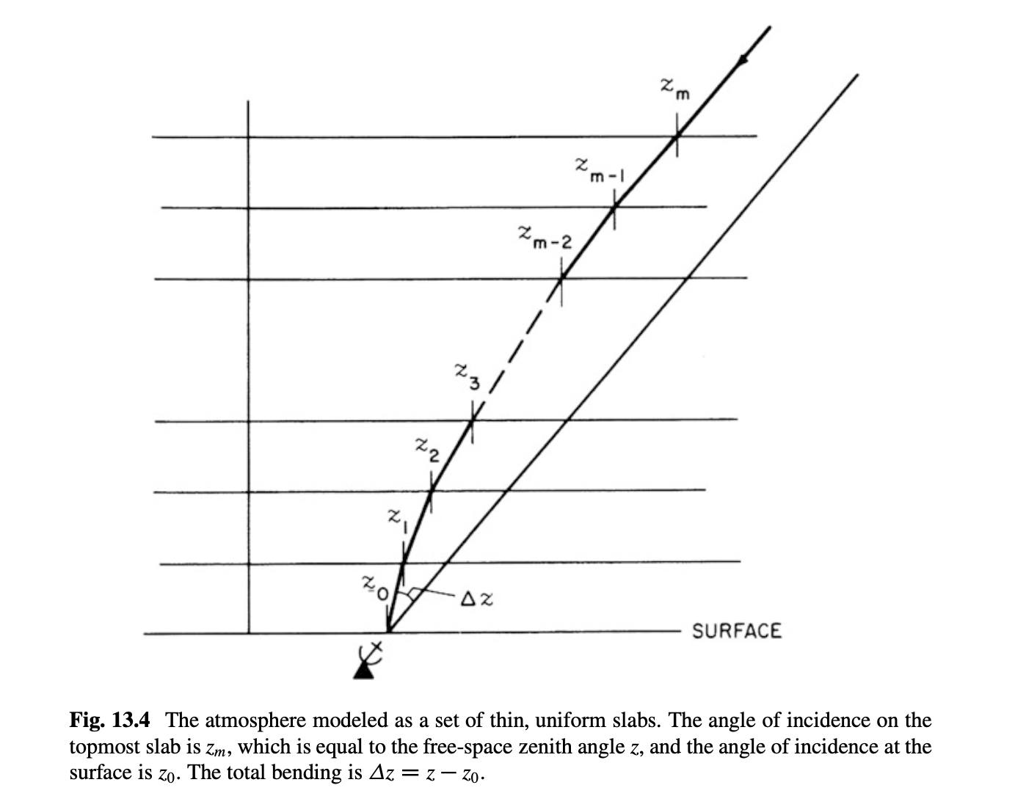
Refraction and pointing at the SMA
Plane-parallel atmosphere. The refractive invariant is n⋅sin(z), so pointing depends on n in the base layer only.
This approximation breaks down at low elevation
Figure from Thompson, Moran, and Swenson 2017, Interferometry and Syntheses in Radio Astronomy, 3rd Edition

Slide 19
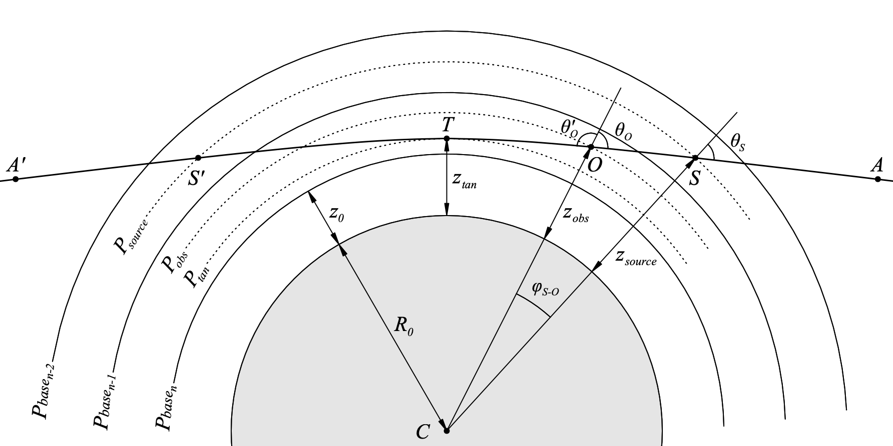
Refraction and pointing at the SMA
Spherical atmosphere. The refractive invariant is n⋅r⋅sin(z), so pointing depends on the refractivity profile. Rays lie on a family of curves like A’-T-A.
Look at pointing effect for SMA median atmosphere + perturbations

Slide 20
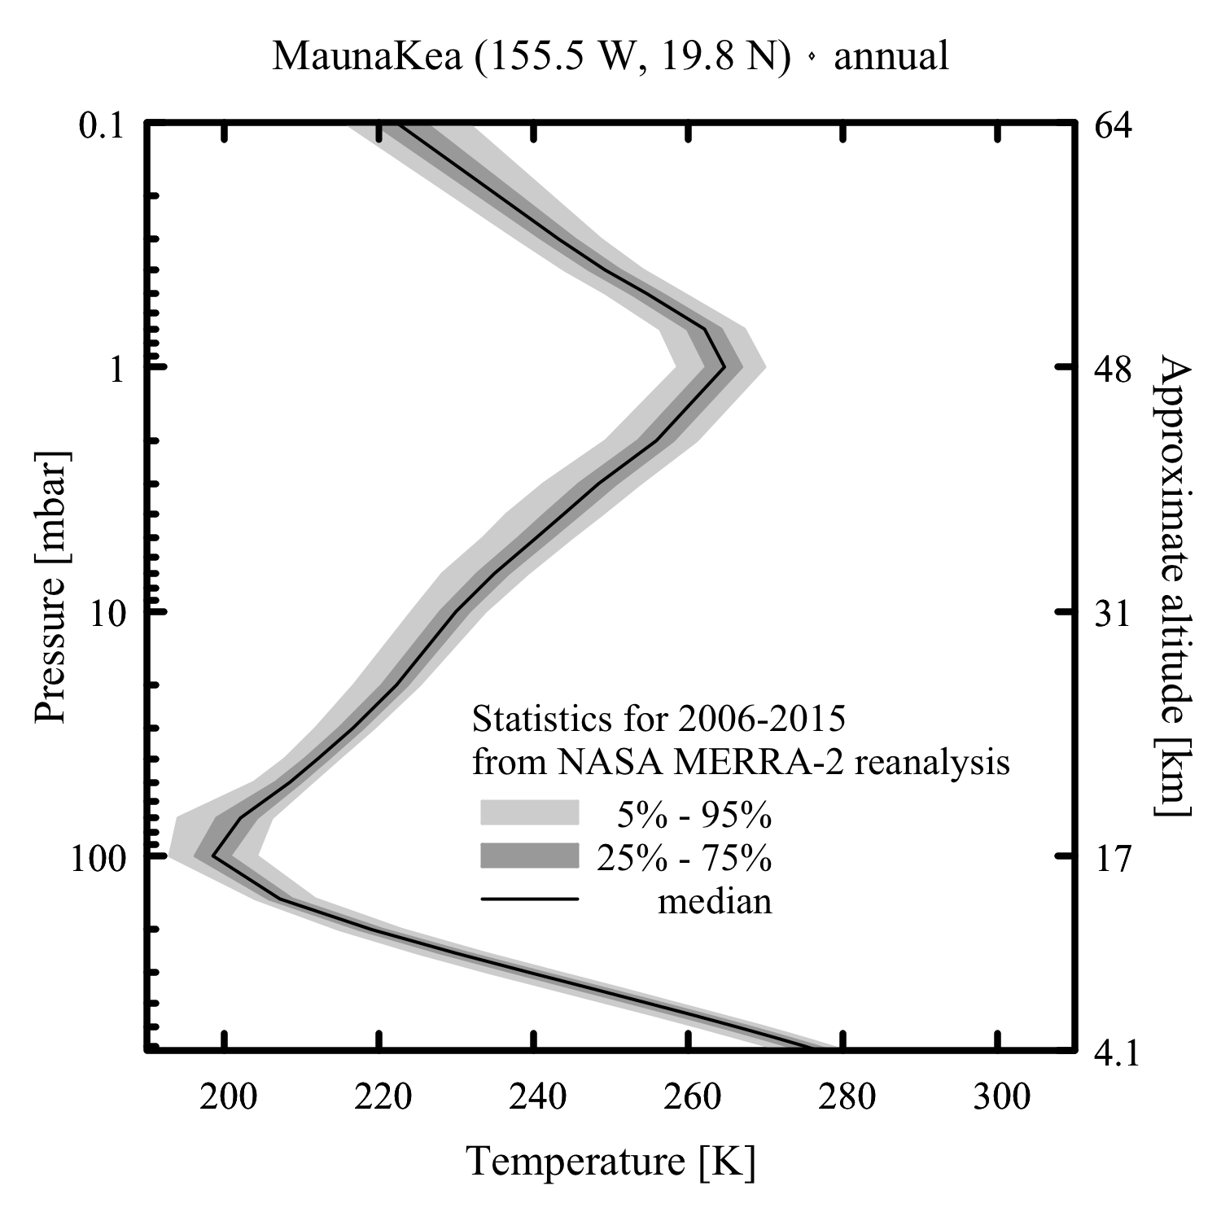
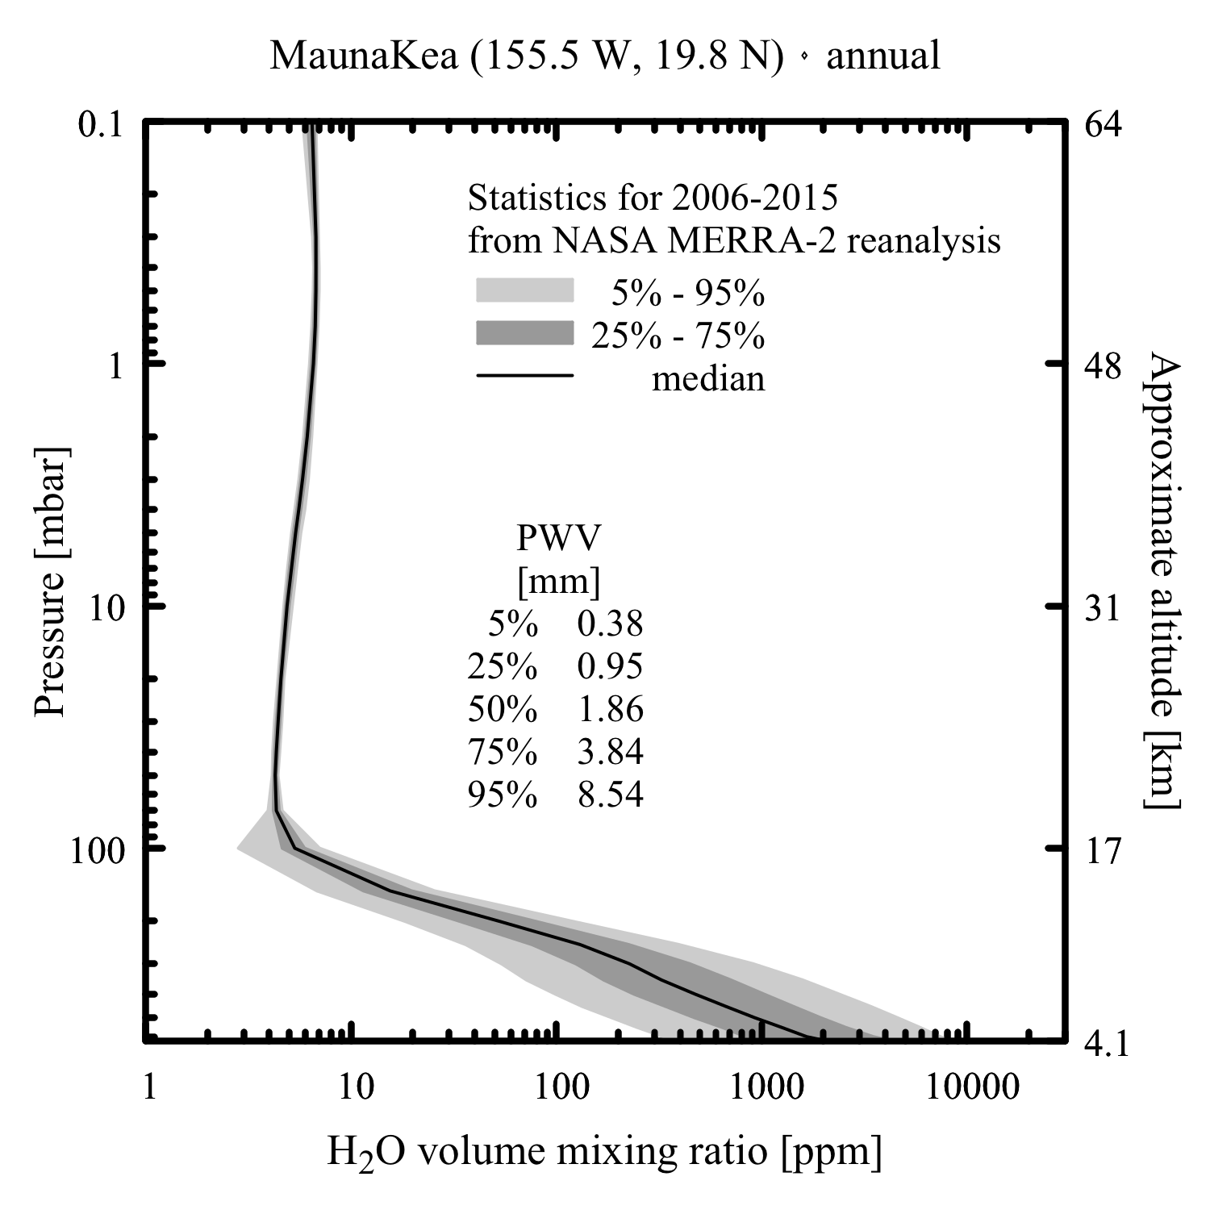
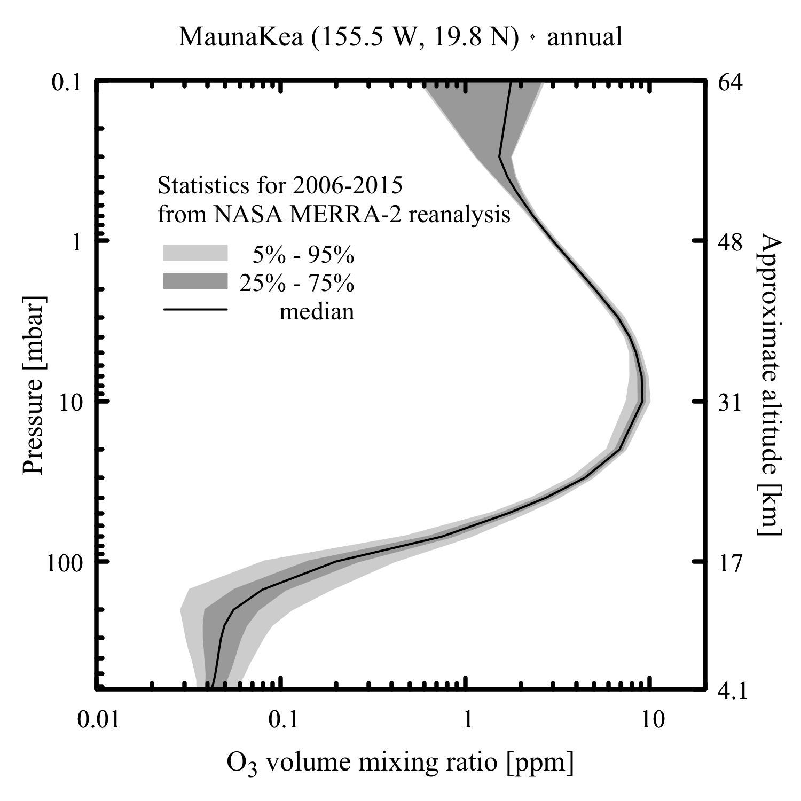
SMA MERRA-2 median atmosphere
Using an am model atmosphere based on these profiles, look at pointing deviations as a function of elevation for median case and for perturbations in surface temperature and water vapor column density.

Slide 21
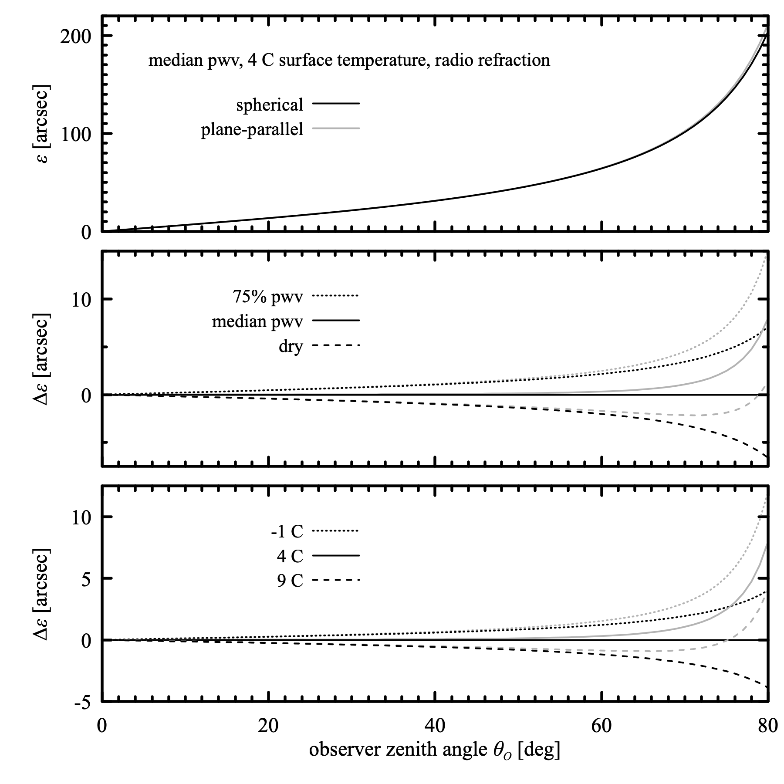
At low elevation, deviation from plane-parallel is significant, but always small compared with the primary beam.

Slide 22
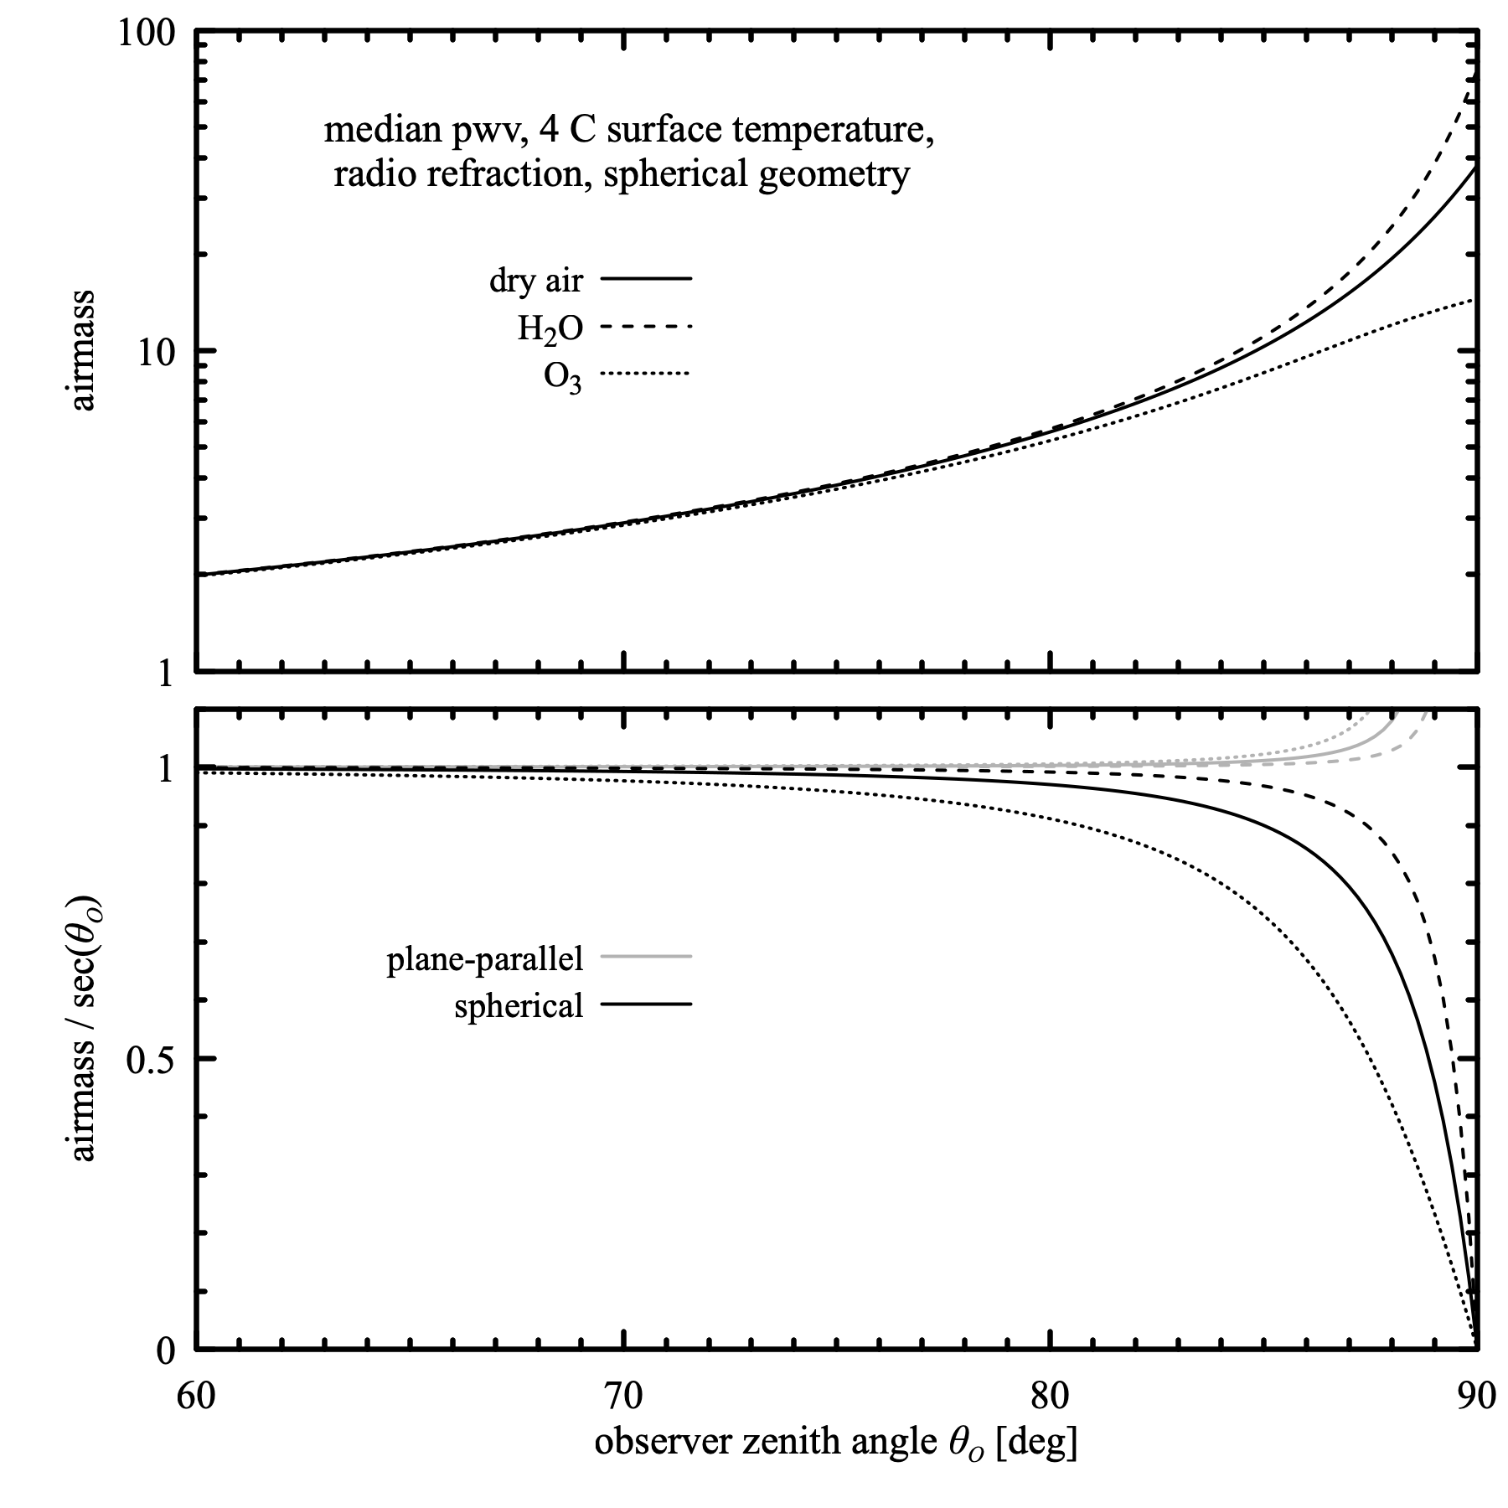
Note change in airmass with elevation for species with different profiles.

Slide 23
Resources
am atmospheric model
Manual: https://zenodo.org/records/640645
Source code or windows installer: https://zenodo.org/records/1193770
sma-met-forecast
On github at https://github.com/Smithsonian/sma-met-forecast

